Slide 1
DIAGNOSIS & TREATMENT PLANNING
IN FIXED PARTIAL PROSTHODONTICS lecture 2
Rungta College of Dental Sciences and Research
DEPT OF PROSTHODONTICS
PRESENTED BY RUCHA KASHYAP

Slide 2
Purpose Statement
At the end of the class the students will be able to
describe how to record case history, do intraoral examination and formulate a treatment plan

Slide 3
LEARNING OBJECTIVES
At the end of the class students should be able to
Sr No. | Learning objectives | Domain | Level | criteria | condition
1. | Describe how to do general oral assessment, examination of teeth. | Cognitive | Must know | All
2. | To learn to do occlusal and periodontal examination | Cognitive | Must know | All
3. | Discuss how to formulate treatment plan | cognitive | Must know

Slide 4
CONTENTS
Intra oral examination
Importance of radiographs
Diagnosis
Occlusion
Esthetics
Treatment planning
Abutment selection
Endodontic consideration
Summary

Slide 5
Oral Examination
General oral assessment:
Evaluation of :-
  Oral Hygiene
  Overall caries activity
  General periodontal status &
  Type of saliva

Slide 6
Examination of teeth
Each tooth is examined for:
Dental caries
Decalcification
Erosion
Abrasion
Occlusion
Attrition
Hypersensitive exposed root surfaces

Slide 7
Occlusal Examination
The following are also noted:
Vertical & horizontal overlap of the anterior teeth
occlusal plane
Vertical dimension of occlusion
Any missing or supraerupted teeth
Rotated teeth
Any evidence of bruxism

Slide 8
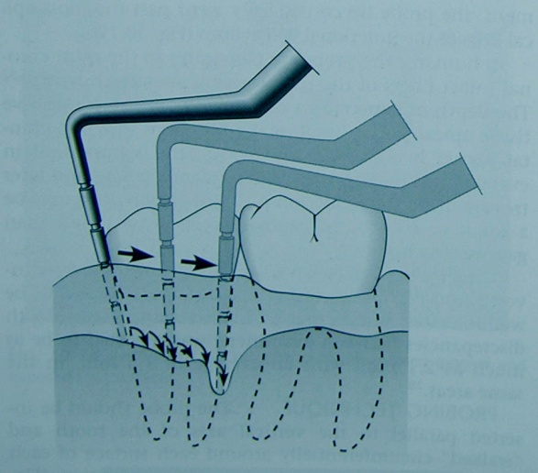
Periodontal Examination
Gingiva is observed for abnormalities in color, size, shape, consistency or texture, as well as areas of recession
The periodontal probe scrutinizes the periodontal pockets, furcation invasions & mucogingival defects.
Mobility patterns of teeth are evaluated

Slide 9
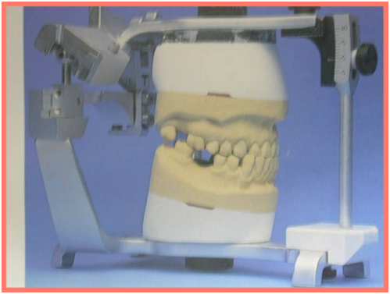
Diagnostic Casts
They are used to evaluate:
Soft tissue contours
Vestibular morphology & frenum attachments
Bony contours
Crown length & morphology
Tooth alignment & path of insertion
Available pontic space

Slide 10
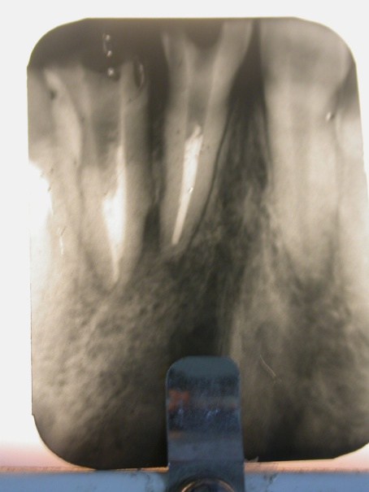
An intra-oral radiographic examination reveals:
Remaining bone support
Root number & morphology (short, long, slender, broad, bifurcated, fused, dilacerated etc.) & root proximity
Quality of supporting bone, trabecular patterns & reactions to functional changes

Slide 11
Pulpal morphology & previous endodontic treatment
Presence of apical disease, root resorption
Retained root fragments, radiolucent areas, calcifications, foreign bodies or impacted teeth

Slide 12
Definitive Diagnosis
After a careful review of all available information, a definitive diagnosis is made
Dental diagnosis commonly includes:
Determination of the periodontal health
Occlusal relationships
TMJ function
Conditions of edentulous areas
Anatomic abnormalities etc.

Slide 13
Treatment Planning
Consideration’s in treatment planning:
1. Patient’s desires, expectations & needs
2. Systemic & emotional health
Elderly or debilitated patient’s, unable to tolerate long appointments of FPD treatment may better served with more conservative care i.e. removable prosthesis

Slide 14

Occlusion
Every fixed restoration affects occlusion.
Our aim should be ‘ Do not harm’ when restoring occlusal surfaces of teeth

Slide 15
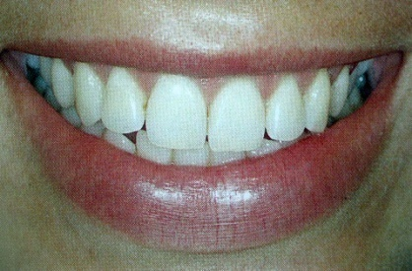
Occlusal restoration with fixed prosthodontics should result in :
Simultaneous equalized contact of all teeth (ant & post) in maximum intercuspation (centric occlusion) at a physiologic vertical dimension of occlusion
A physiologic plane of occlusion

Slide 16

Esthetics
Patient’s concern with esthetics should not be underestimated
Every effort should be made to produce an esthetic result without compromising functional requirements
Porcelain has excellent esthetic potential.

Slide 17
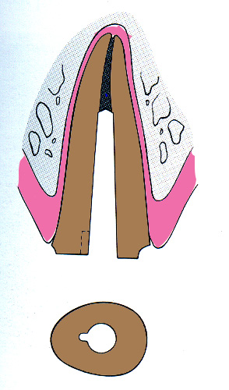
Endodontic Considerations
Endodontically treated teeth can successfully function as abutments to an FPD.
However, a post and core is usually required as these teeth are weakened by the loss of supporting dentin

Slide 18
Abutment Selection
Bone support:
Ante’s Law: Abutment teeth should have a combined pericemental area equal to or greater than the tooth/teeth to be replaced
Other equally important parameters:
Crown to root ratio
Root morphology
Occlusal conditions

Slide 19
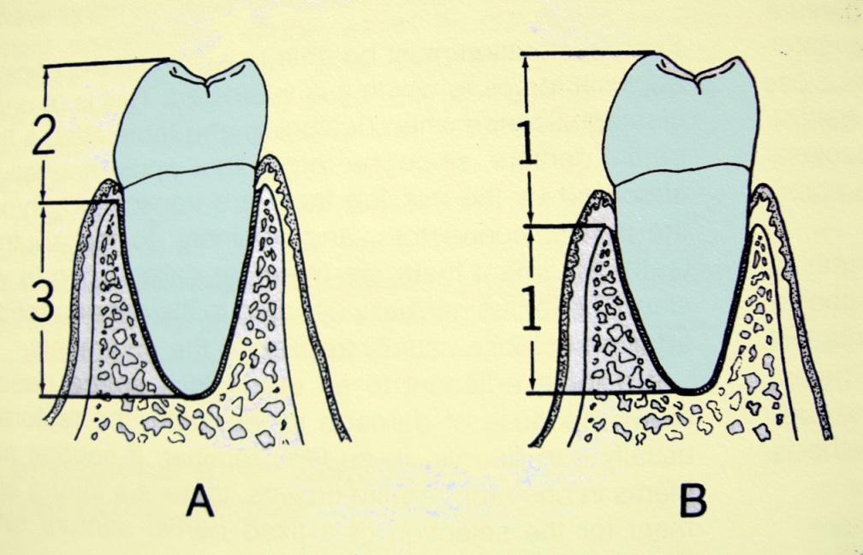
Crown-root ratio
Favorable crown: root ratio is 1:1 .
Poorest prognosis: teeth with short, conical or blunted roots
Best prognosis: Irregularly shaped roots or with divergent multiple roots
Favorable
crown: root ratio

Slide 20
Comprehensive planning-A comprehensive sequential approach to treatment planning is essential.
Prognosis-The dentist should propose a treatment plan that offers a favorable prognosis. The less disease present at the onset and the less complex the treatment, the more favorable the prognosis.

Slide 21

Successful treatment is the result of a logical diagnosis and a rational sequence to the treatment plan.
A comprehensive oral examination, distinct radiographs and well defined diagnostic casts are essential ingredients for diagnosis.
The approach to treatment planning should be meticulous, flexible and scholarly.

Slide 22
TAKE HOME MESSAGE
The clinicians who familiarize himself with precision attachments will add a new dimensions to his treatment options
Proper maintenance and care by the patient and regular follow up decides on the long term success of the attachment and prosthesis.

Slide 23
Bibliography
  1. Rosenstiel R.F., Land M.F., Fujimoto J. : Contemporary fixed prosthodontics. 1st Ed., Mosby Publications, 1988. Pg 3-45
  2. Shillingburg H.T., Hobo S., Whisett L.D., Jacobi R., Brackett S.E. : Fundamentals of fixed prosthodontics, 3rd Ed., Quintessence Publication, 1997.Pg 1-9
  3. Tylman S.D. Theory and Practice of Crown and Bridge Prosthodontics. Ed. V St. Louis 1965. C.V Mosby Company. Pg 1-23

Slide 24
QUESTIONS
EVALUATION OF ABUTMENT TEETH
DIAGNOSTIC CAST AND ITS IMPORTANCE IN FPD
PIER ABUTMENT AND ITS SIGNIFICANCE
DOUBLE ABUTMENT

Slide 25

Thank you

